Slide 1
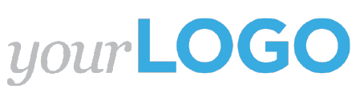
Snapshot Report
How to generate revenue

Slide 2
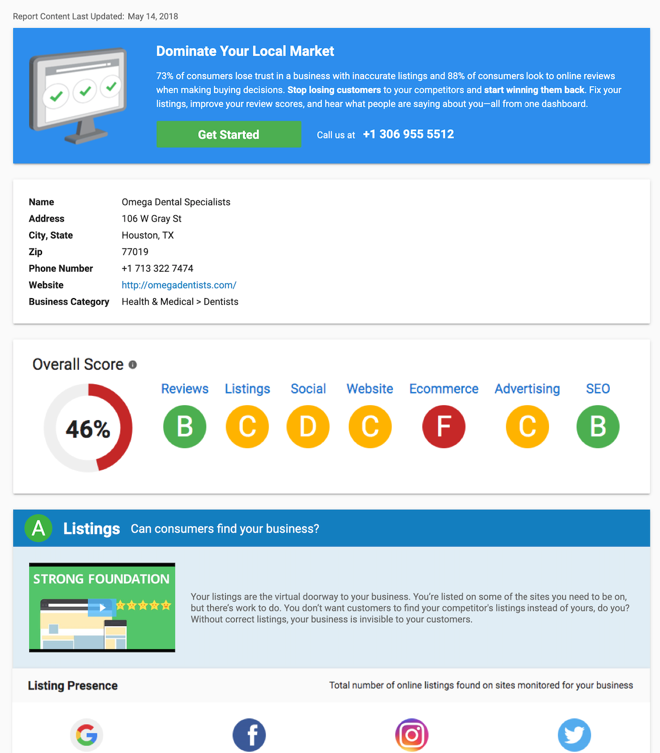
What is the Snapshot Report?
The Snapshot Report is an award-winning marketing needs assessment that arms sales reps with automated insights into a business’s online marketing performance. These insights make for compelling and persuasive sales pitches.
Use the Snapshot Report to start conversations with business owners, highlight gaps in their marketing, and propose optimal solutions.

Slide 3
Benefits
The Snapshot Report equips you to:
Uncover a business’s hidden marketing needs
Identify hot leads with instant notifications
Engage prospects in conversation
Build trust with transparency
Leverage known opportunities
Propose strategic solutions
Get your foot in the door and win your next consult!
Notes:
The Snapshot Report links to our CRM and sends you a notification the moment your prospect opens the report. This empowers you to identify hot leads and accelerate the sales cycle.

Slide 4
Overview

Slide 5
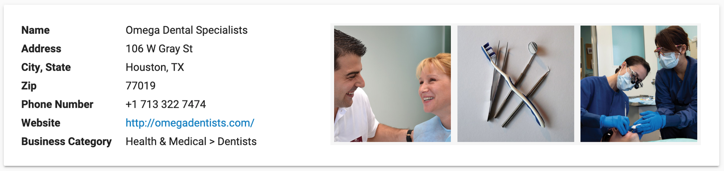
Business Information
The first section of the Snapshot Report specifies information about your prospect’s business. This information is used to search for your prospect’s digital marketing data and see how they perform within their industry.
Before sending the Snapshot Report, confirm that this information is absolutely correct. Our grading algorithms require exact matches!
Notes:
The Snapshot Report uses this Business Information as a reference when verifying online listings. Confirm that this information is displayed just as your prospect would like it to be - any listing that does not match this information exactly will be flagged as incorrect.
For example, a prospect’s (Omega Dental) address is displayed as “106 W Gray St”. If the address is listed online as “106 West Gray St” or “106 W Gray Street,” that listing will be flagged as incorrect.
Business Category: Businesses are classified by Industry > Business Category. The Snapshot Report compares your prospect to others within their Industry.
The Snapshot Report pulls images of your prospect’s business from public web sources. Some businesses may be surprised when they see these images since they may not realize that these photos are online.

Slide 6
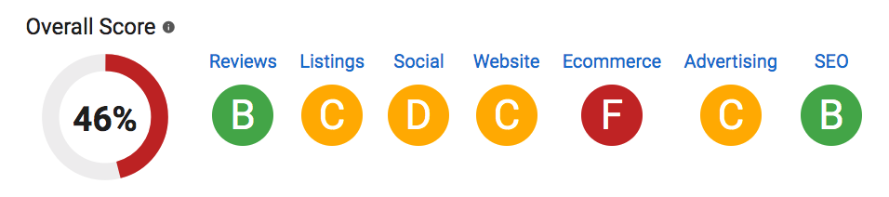
Overall Score
Your prospect’s Overall Score indicates how well their digital marketing is performing in comparison to other businesses in the same industry. There’s no pass / fail here—a business should strive to be as close to 100% as possible.
Whether your prospect scores an A or an F, there’s plenty of work to be done!
Notes:
A score of 100% indicates that the business is a top performer in each of the marketing categories.
If you disable a category, the report automatically re-calculates the score.

Slide 7
Overall Score
The Overall Score is calculated by converting each section grade into a numerical score. This scoring chart is used:
A=4 | B=3 | C=2 | D=1 | F=0
Then, these scores are added and divided by a perfect score (4 X # of section grades). The result is displayed as a percentage and rounded to the nearest whole number.

Slide 8
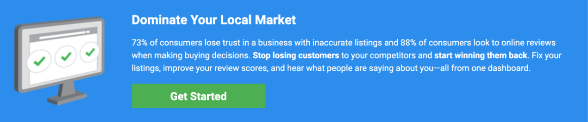
Call to Action
At the top and bottom of the report, there is a call to action that drives your prospect into the Business Center. There, they can browse your products and solutions.
Make sure to set up your online store in Business Center before sending the report!

Slide 9
Listings

Slide 10
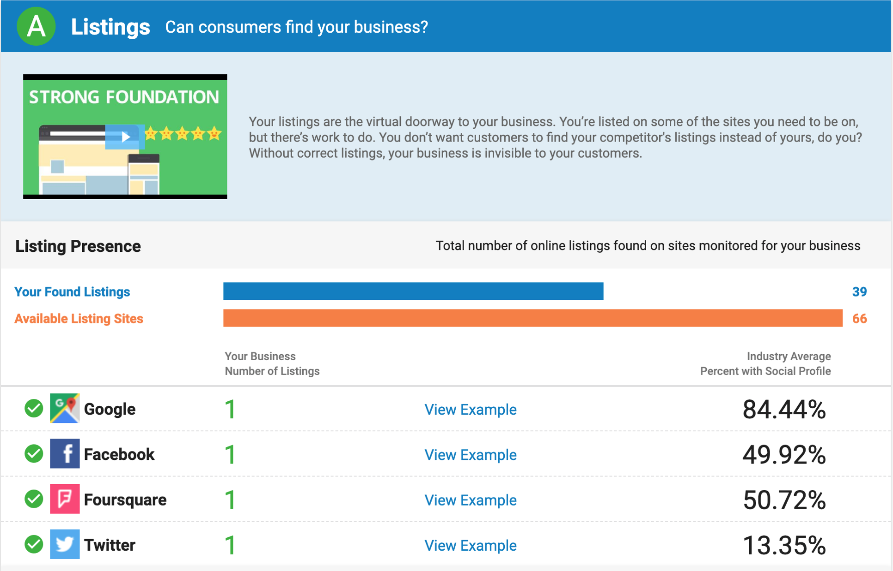
Listings
The Snapshot Report aggregates data from over 70 directories to show your prospect:
Number of listings
Accuracy of listings
Missing sites
Local businesses need accurate listings on many directories to ensure that customers can find them online.
Put your prospect on the map with an abundance of accurate listings.

Slide 11
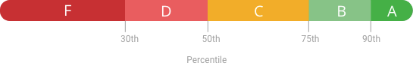
Listings Grade Calculation
Each listing source is assigned a score based on how popular the site is. For example, having an accurate listing on a popular site like Google Maps will have a greater influence on the score.
The Listings grade is determined by the percentile range your prospect falls into when compared to other businesses in the same industry.

Slide 12
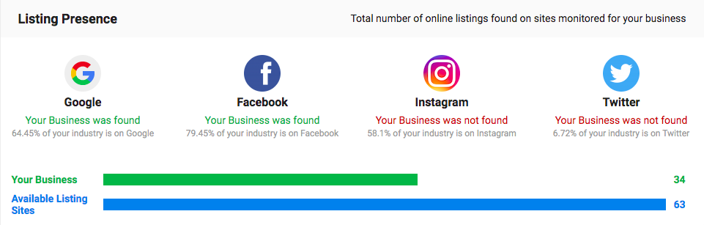
Listing Presence
A strong listing presence improves your prospect’s search ranking and makes them discoverable. Without online listings, your prospect will lose customers to competitors.
If the grade is high, it’s important to keep it that way! Listing Distribution can ensure that your prospect’s listings remain present online.
If the grade is low, it’s Listing Distribution and Reputation Management to the rescue! Listing Distribution can create and distribute listings across major sources. Reputation Management will display which listings are missing.
Notes:
This section asks: “is this business found on as many listing sources as it can be?”
A Reputation Management account is created for every Snapshot Report that is developed. Investigating the Reputation Management account provides more information around the listing score.

Slide 13
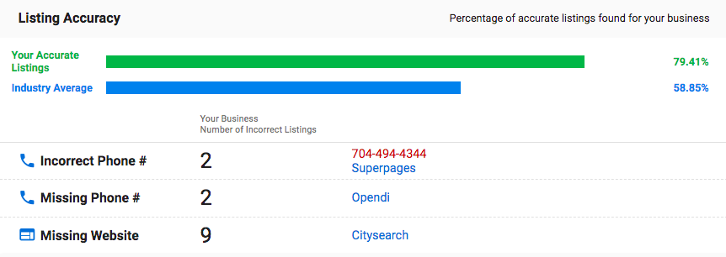
Listing Accuracy
Accurate listings ensure a customer can find and contact a business. Incorrect listings lead to unhappy and frustrated customers. Your prospect’s business must be listed correctly!
If the grade is high, it’s important to keep it that way! Listing Distribution can ensure that your prospect’s listings remain correct over time. If your prospect ever moves, their location will be updated on 300+ sources across the web.
If the grade is low, Listing Distribution and Reputation Management can help! Listing Distribution corrects and maintains current listings across major sources. Reputation Management reveals where information is listed incorrectly.
Notes:
To view more information about incorrect listings, you can access the business’s account in Reputation Management.
Keep in mind that some of the inconsistencies could be due to small variations in how the information is displayed.
If a business has an A, they could still benefit from help with maintaining their listings and making sure they stay consistent. You can build in some fear of loss into your conversation and ask: “How do you know that your listings are always going to be right?” Automated solutions out there can revert to the old data. Competitors could create rogue listings. Reputation Management will listen to those sites and let your prospect know if their listings ever become incorrect.

Slide 14
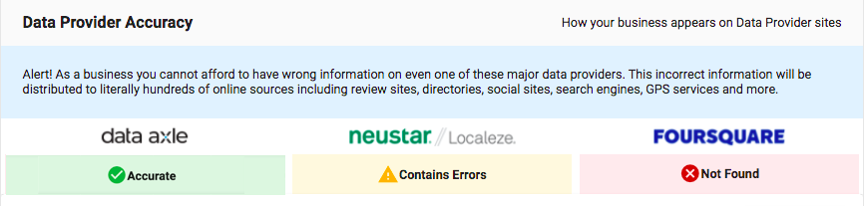
Data Provider Accuracy
There are three major listing providers in the United States: Data Axle, Neustar (Localeze), and
Foursquare. These data providers are referenced by over 300 online listing directories and disseminate business information all over the web.

Slide 15



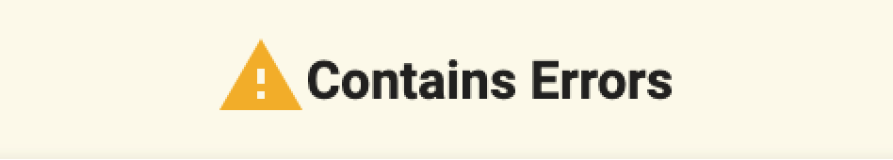

Data Provider Accuracy
Business listings are healthy!
The listings exist (presence), and they are correct (accuracy).
This is no small feat. Ensure listings remain healthy with Listing Distribution.
There is real trouble here! Although some business listings have been found, they are not accurate. Somewhere and somehow, the wrong information about your prospect’s business got out and is now being circulated all over the web.
Offer Listing Distribution pronto to help correct these costly errors.
Looks bad, but it’s not as bad as you think! Not being found is better than being found with errors.
Offer Listing Distribution to push out the correct data.

Slide 16
Reviews

Slide 17
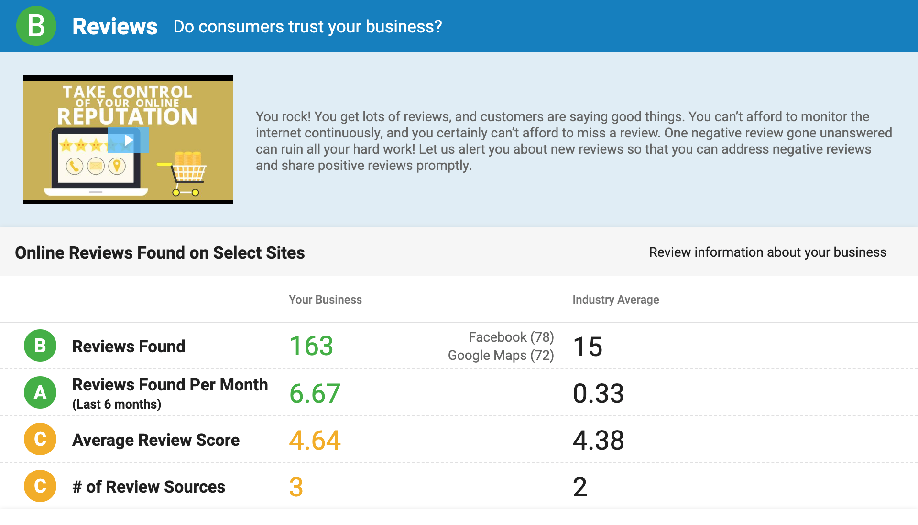
Reviews
The Snapshot Report aggregates data from over 30 customer review sites to highlight:
Number of reviews
Recency of reviews
Average score
Local businesses must continually collect fresh reviews and strive for 5–star ratings to establish trust and credibility. Help your prospect make a stellar first impression.
Notes:
Reviews are hugely important, so talk to your prospect about them! 90% of consumers make their decisions based on what online reviews say.

Slide 18
Reviews Grade Calculation
Each grade in the Reviews section is determined by the percentile range your prospect falls into when compared to other businesses in the same industry.
To determine the overall Review grade, the individual sections are converted into numerical scores:
A=4 | B=3 | C=2 | D=1 | F=0
The sum of these scores is divided by the number of individual grades within the Reviews section. Finally, that score is converted back into a letter grade.

Slide 19

Selling Reviews
If the grade is high, congratulate your prospect on their hard work in earning a solid reputation! Offer Social Marketing to amplify all that positivity.
If the grade is low, you can help! Offer Reputation Management to reveal where the negative sentiment is coming from. Add Customer Voice to the package to provide the perfect avenue for collecting more reviews. Positive reviews can easily be displayed on your prospect’s website, whereas negative reviews can be dealt with privately.

Slide 20
Social

Slide 21
Social
The Snapshot Report investigates a business’s social media presence:
Facebook: Likes, Average Posts/Month, Average Likes/Post, Average Shares/Post
Twitter: Followers, Following, Tweets*
Instagram: Followers, Posts*
Social channels can help local businesses grow their fan base and turn online leads into raving customers. Every day, millions of consumers declare their buying intentions on social media. Local businesses must keep their followers engaged to grow their audience and build brand loyalty.
* Total number

Slide 22
Social Grade Calculation
Each grade in the Social section is determined by the percentile range your prospect falls into when compared to other businesses in the same industry.
To determine the overall Social grade, the individual sections are first converted into numerical scores:
A=4 | B=3 | C=2 | D=1 | F=0
The sum of these scores is divided by the number of individual grades within the Social section. Finally, that score is converted back into a letter grade.

Slide 23
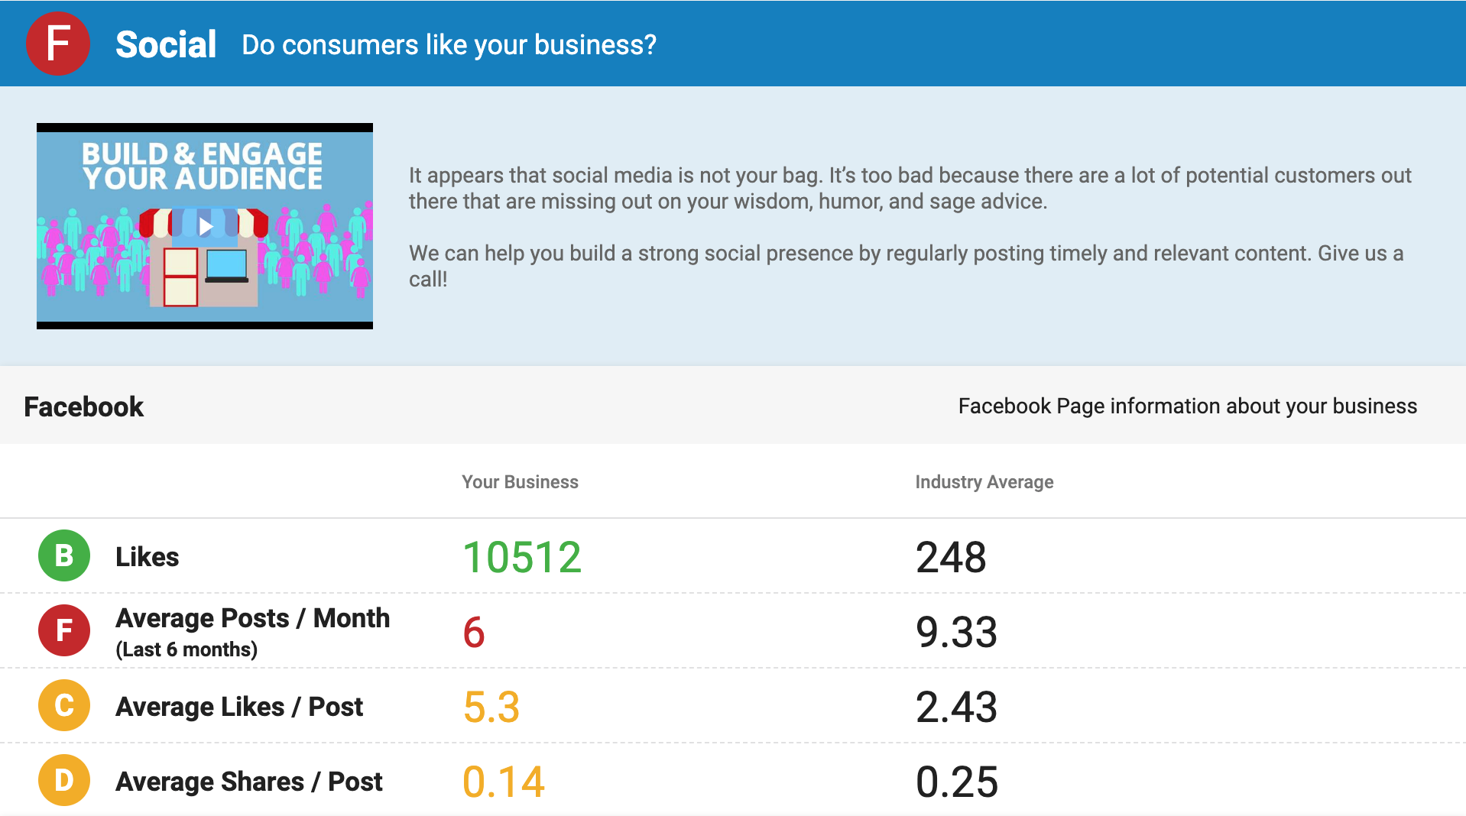
Selling Social
If the grade is high, your prospect is off to a great start! However, managing multiple social networks is difficult and time-consuming. Social Marketing is an easy way for your prospect to continue to build their social presence and find new leads.
If the grade is low, you need to get your prospect to the 21st century where customer service lives online! With Social Marketing, your prospect can manage customer activity in a single feed, respond to customers straight from the feed, and track every interaction.
Notes:
The “Tweets” value in the Twitter section refers to the total number of tweets the profile has published in all time.

Slide 24
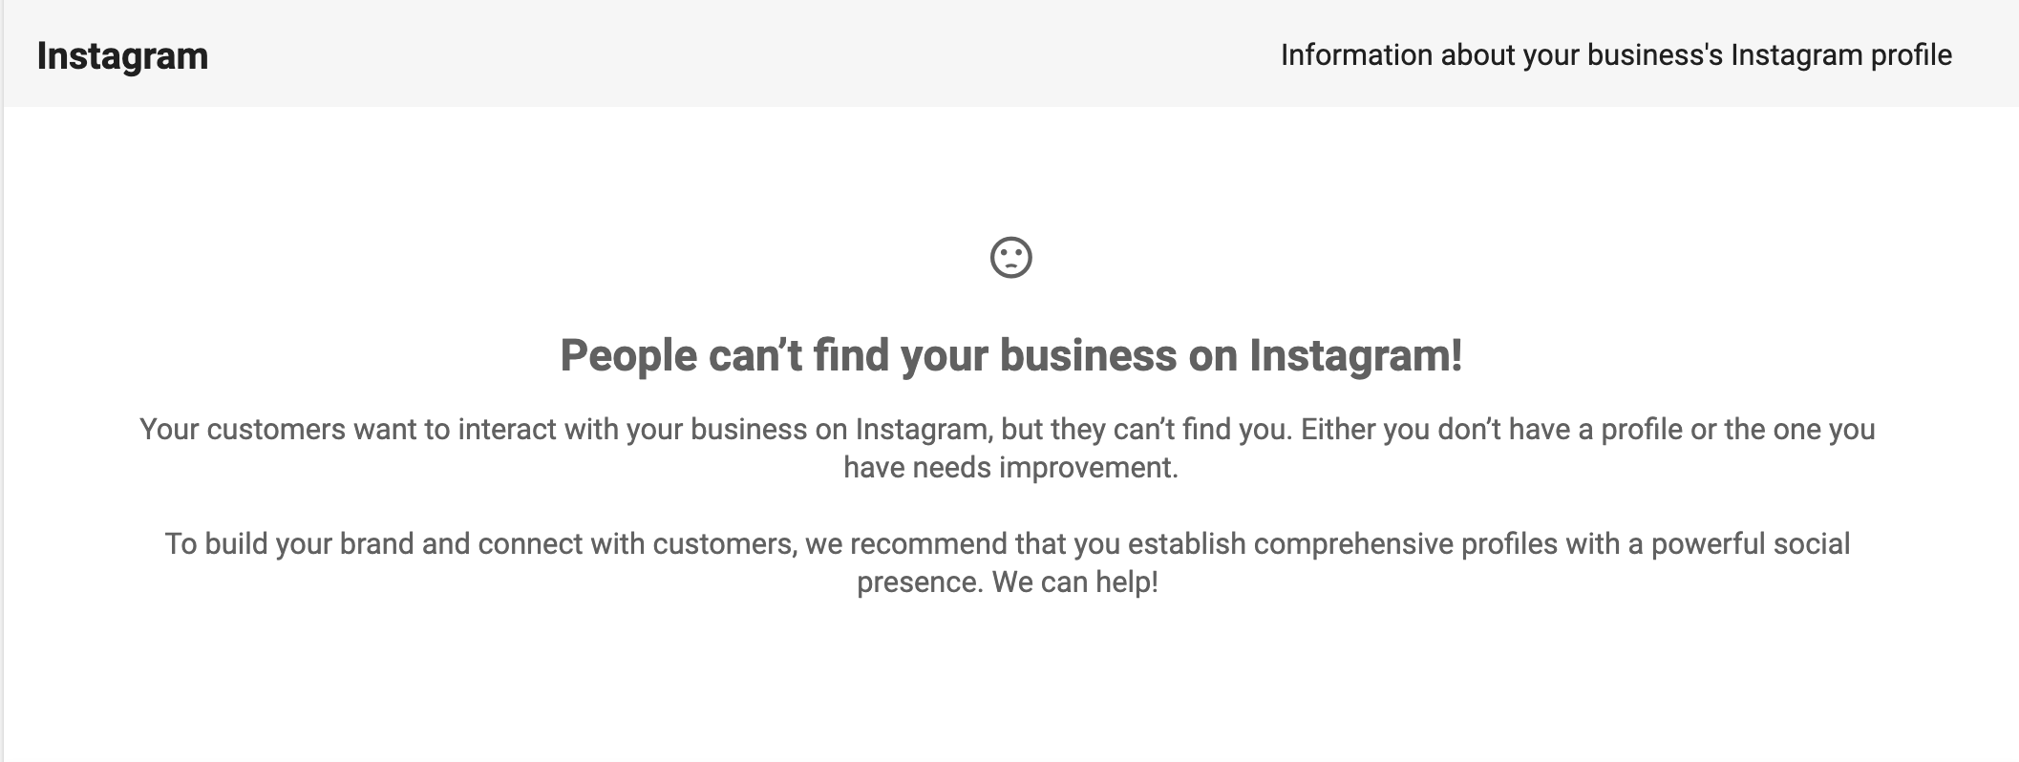
Selling Social
A social page may not appear in the report for several reasons. It could mean that your prospect does not have a page for their business, they are using a personal page instead of a business page, or their page has viewing restrictions. In any case, you can help your prospect. Remember, if our system has a hard time finding your prospect’s social page, their customers will too.

Slide 25
Website

Slide 26
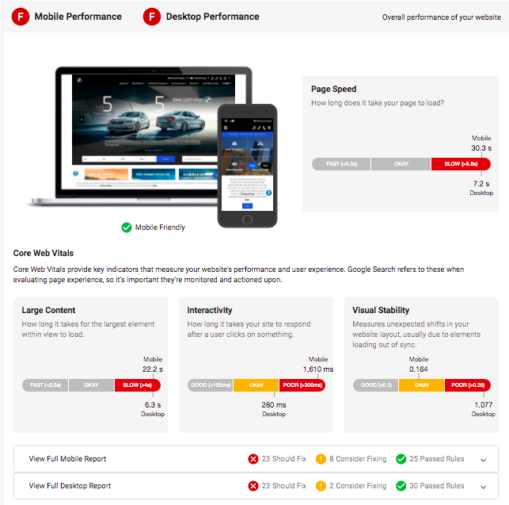
Website
The Snapshot Report leverages Google PageSpeed Insights and Core Web Vitals to assess your prospect’s website.
The website section looks at:
Mobile responsiveness
Desktop load speed
Homepage content

Slide 27
Website Grade Calculation
Each grade in the Website section is determined by the percentile range your prospect falls into when compared to other businesses in the same industry.
To determine the overall Website grade, the individual sections are first converted into numerical scores:
A=4 | B=3 | C=2 | D=1 | F=0
The sum of these scores is divided by the number of individual grades within the Website section. Finally, that score is converted back into a letter grade.

Slide 28
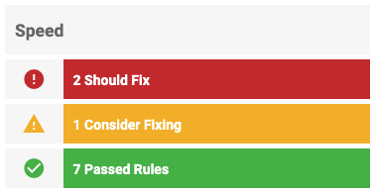
Website Performance Metrics
Your prospect’s website loading speed is critical. There are a variety of factors that affect this performance.
Using PageSpeed Insights, we assess whether your prospect’s website meets Google’s expectations for page speed. We then display recommendations for issues to fix.
Should Fix: Rules that failed PageSpeed Insight’s tests.
You should fix these immediately.
Consider Fixing: Rules that passed PageSpeed Insight’s tests, but could use improvement. You might consider fixing these issues, but they’re not necessarily critical.
Passed Rules: Rules that passed PageSpeed Insight’s tests.

Slide 29
Website Performance Metrics
The Snapshot Report assesses ten speed metrics in total:
Eliminate Render-Blocking JavaScript and CSS in Above-the-Fold Content: When a page includes render blocking external stylesheets, which delays the time to first render.
Leverage Browser Caching: When the response from your prospect’s server does not include caching headers or if the resources are specified to be cached for only a short time.
Optimize Images: When the images on the page can be optimized to reduce their file size without significantly impacting their visual quality.
Minify HTML: When the size of one of your prospect’s resources could be reduced through minification.
Enable Compression: When compressible resources were served without gzip compression.
Minify CSS: When the size of CSS could be reduced through minification.
Minify JavaScript: When the size of JavaScript could be reduced through minification.
Reduce Server Response Time: When your prospect’s server response time is above 200 ms.
Avoid Landing Page Redirects: When you have more than one redirect from the given URL to the final landing page.
Prioritize Visible Content: When additional network round trips are required to render the above the fold content of the page.

Slide 30
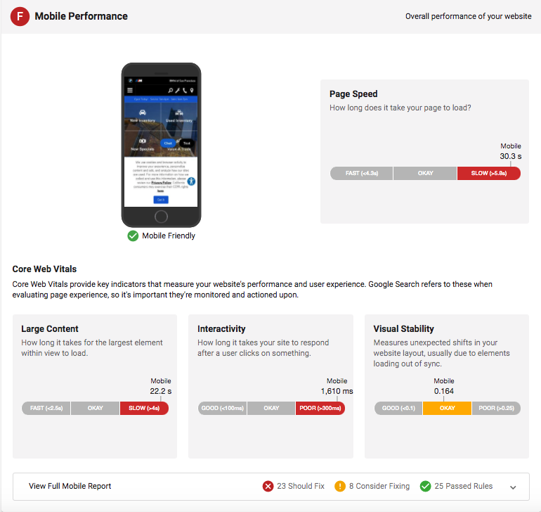
Mobile
This section investigates what your prospect’s website looks like on a mobile device. With the majority of first-time searches being done from a mobile device, your prospect needs a mobile-friendly site that delivers the information that people are seeking.
Note: The grade for this section is based on the Speed rules only.
If the grade is high, your prospect is on the right track!
If the grade is low, uh oh! Your prospect has two choices—fix what’s broken or take advantage of a mobile- optimized Location Page. It’s simple to create, search engine optimized, and most importantly, mobile responsive!

Slide 31
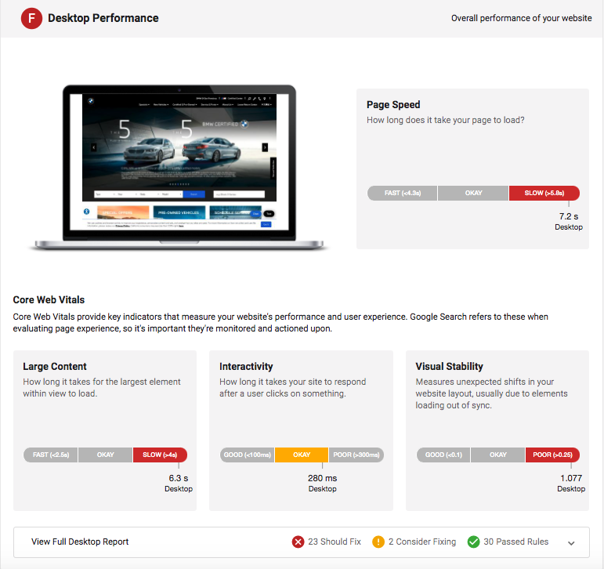
Desktop
This section investigates your prospect’s website speed on Desktop. The faster their page loads, the more engaged their customers will be. If a site takes too long to load, customers will likely go elsewhere. Time is money!
If the grade is high, your prospect’s site is quick! But is there anything else you can do to decrease the load time? After all, there’s no such thing as a site that loads too quickly.
If the grade is low, looks like you’ve got a few things to fix! Use Website Pro for effortless and dependable Wordpress hosting that is fast, secure and backed–up automatically.

Slide 32
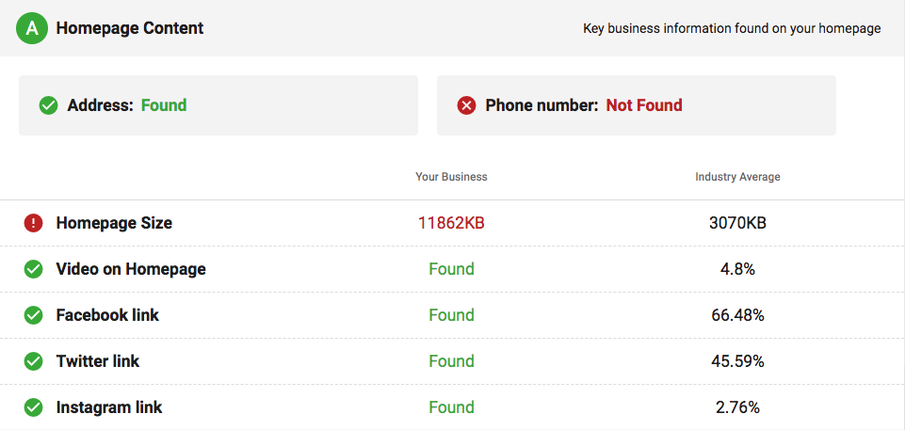
Homepage Content
This section investigates the effectiveness of your prospect’s homepage. Vital information needs to be laid out clearly on the first page a customer lands on. First impressions count! Your prospect’s business information, location information, and links to social media are arguably the most important content on your prospect’s website.
If the grade is high, great! Now, does your prospect have multiple tabs or pages to their business’s website? If so, is all this information readily available on them too? You can take it one step further and collect reviews on this killer site with the Review Generation Widget (Customer Voice)!
If the grade is low, uh oh! Your prospect has two choices - fix what’s broken or take advantage of a mobile-optimized Location Page. It’s simple to create, search engine optimized, and additional tabs can easily be added. No coding knowledge required!
Notes:
Homepage Content: Contact information should be available on the homepage.

Slide 33
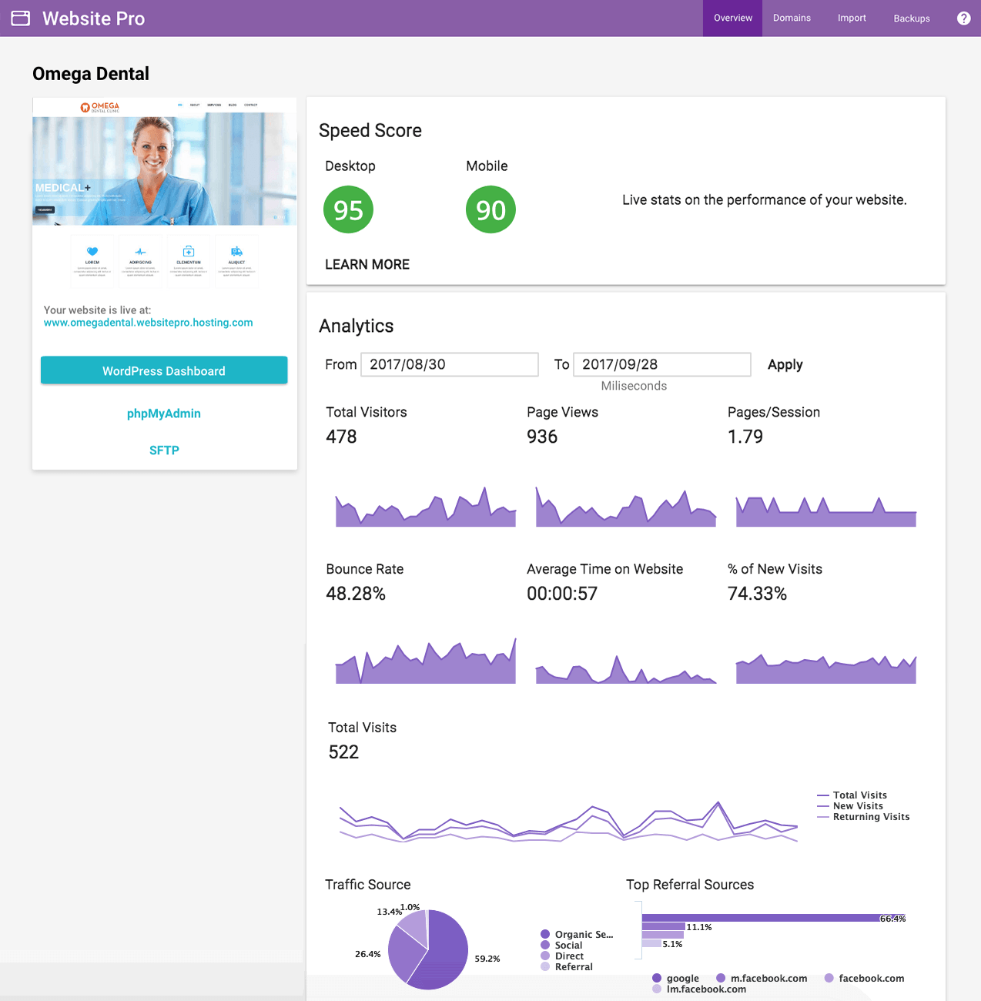
Selling Website
If your agency provides website services, offer to strengthen your prospect’s website performance.
If you do not provide these services, leave this information with your prospect so they can address the issues with their web developers. Providing this detailed information will help build a trusting relationship with your prospect.

Slide 34
Digital Advertising

Slide 35
Why Digital Advertising?
Consumers are searching for your prospect’s business services online. If they can’t find your prospect’s business, your prospect will miss out on sales opportunities.
Online advertising puts your prospect’s business in front of targeted audiences in search results, social media feeds, and other relevant sites around the web. Targeted ad campaigns build your prospect’s brand awareness, drive traffic to their website, and help them grow their customer base. By making sure that customers can find your prospect’s business online, you will empower your prospect to grow their business and secure their place in the market.

Slide 36
Digital Advertising Insights
The Snapshot Report provides valuable data on your prospect’s digital advertising performance and potential. The advertising section of the report offers insights from:
Google Ads: The type of Paid Keywords, CPC, and PPC results your prospect could receive if they were using an advertising solution, along with competitor campaign comparison.
Facebook: Whether or not your prospect has taken advantage of retargeting.
Local businesses need to own the right keywords to ensure that their target audience knows about them. Uncover golden opportunities for your prospect with search, social, and display advertising.
Notes:
CPC = Cost-Per-Click
PPC = Pay-Per-Click

Slide 37
Google Ads
The impressions and clicks in the Snapshot Report are an indication of revenue growth potential based on Google Ads. You can leverage this data and knowledge of Google Ads to help make your sale.
Google Ads is based on SEM (Search Engine Marketing), a method of advertising where the desired result is to increase the visibility of a business’s website when a specific set of keywords is searched. Advertisers determine the keywords that are relevant to their business, then use the Google Ads platform to bid on Paid Keywords and promote their ads in relevant search results. Cost-Per-Click (CPC) is the estimated final cost that advertisers are charged to appear for Google search keywords. With Google Ads, advertisers only pay when users click on the ad. This is called the Pay-Per-Click (PPC) model.

Slide 38
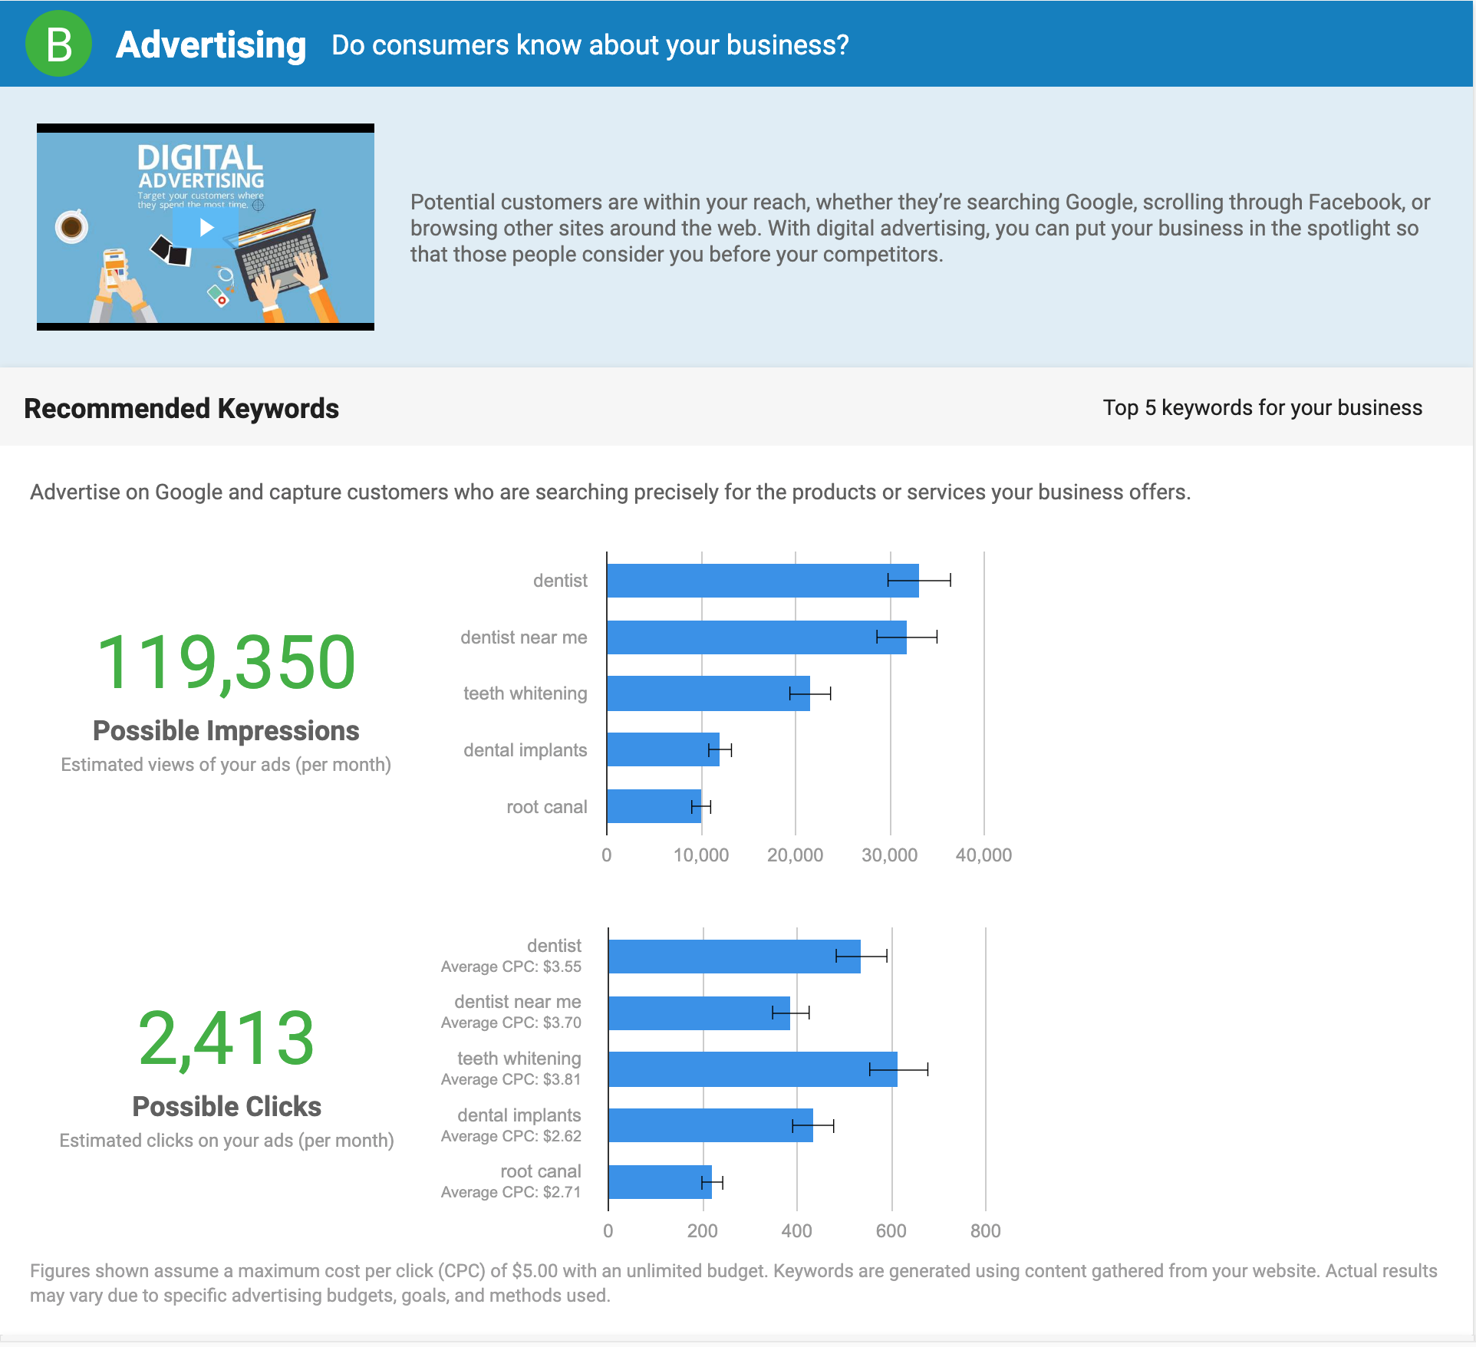
Recommended Keywords
What is the opportunity?
This section identifies the top five keywords for your prospect’s business, based on content gathered from their website and location.
The report shows the average CPC for these keywords. It also displays the potential results of running a dedicated ad campaign over one month that focuses on these keywords. Imagine the excitement your prospect would feel about receiving this exposure for their business!
Notes:
The figures shown assume a maximum cost per click (CPC) of $5.00 with an unlimited budget.
Actual results may vary due to specific advertising budgets, goals, and methods used.

Slide 39
Campaign Performance
This section examines how your prospect’s existing campaigns stack up against their competition. Here, the Snapshot Report examines:
The number of paid ads your prospect and their competitors have purchased in the most recent month.
The estimated number of clicks received from all their paid keywords.
The approximate Google Ads spend in the last month.
This data provides you and your prospect a view of what high-performing competitors are doing, and what your prospect must do to compete.

Slide 40
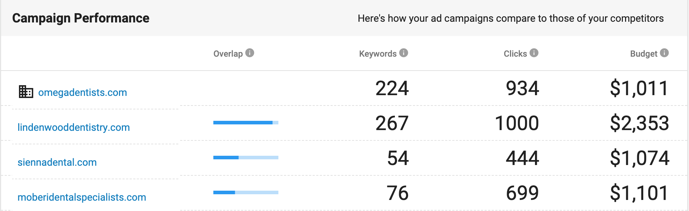
Campaign Performance
Show your prospect how their advertising stacks up against their competitors:
Overlap: How similar your prospect’s campaigns are to their competitors, based on common keywords.
Keywords: The number of paid ads your prospect and competitors have purchased in the most recent month.
Clicks: The estimated number of clicks your prospect and competitors get from all their paid keywords.
Budget: The estimated Google AdWords spend for your prospect and their competitors in the last month.
Your
prospect’s competitors
Your prospect

Slide 41
Advertising Grade Calculation
The Advertising grade is determined by the percentile range the campaign’s estimated cost per click falls into when compared to other businesses in the same industry.
Estimated Cost per Click = Estimated Monthly Ad Budget / Estimated Monthly Paid Clicks
Notes:
Note: Only Google AdWords are considered in this section.
The industry leader with the lowest cost per click is the 100th percentile.

Slide 42
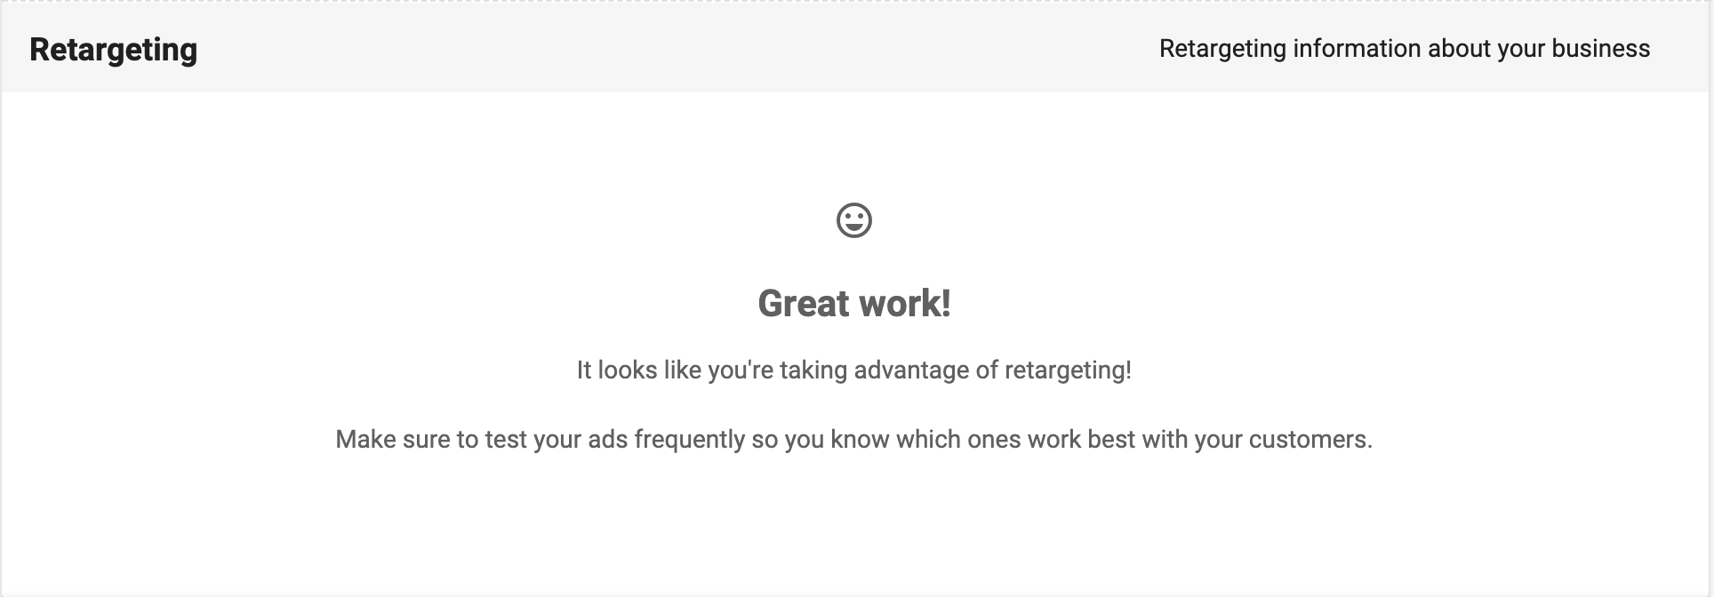
Retargeting
This section offers insights from Facebook on whether a business is taking advantage of retargeting—a method where advertisers display targeted ads to people who have already visited their website. People don’t always convert the first time they visit a website. Retargeted ads will keep your prospect’s business top-of-mind and direct customers back to their site. These ads can boost conversions and grow revenue!

Slide 43
Selling Digital Advertising
Use the insights uncovered in the Snapshot Report to guide the sales conversation around digital ads. Offer the Digital Ads Setup package, with any combination of add-ons, to target your potential customers, drive more sales, and maximize ROI. Our Digital Ads services include a variety of campaigns—including search, display, Facebook, LocalAds, and Youtube—and native ads.
If the grade is high, great! Your prospect is spending money, but they likely aren’t optimizing it. There’s always room for growth.
If the grade is low, your prospect is losing potential customers! If consumers aren’t buying with your prospect, they are going to buy from the competition. Ask your prospect to search for their services/products using general keywords. Do they show up? Or is their competition showing up?

Slide 44
Selling Digital Advertising
Follow these steps to sell digital advertising to your prospect successfully:
Ask your prospect to consider their buying journey.
“What steps would you take if you wanted to find a good, local, and inexpensive restaurant for dinner tonight?”
Ask your prospect to consider their business’s place within that journey.
“Would it be valuable for your business to show up in searches when people use keywords related to the products and services you offer? People are much more likely to engage with your ad when they are actively searching and ready to make a purchase. How much is it worth to get that once click from a qualified audience?”
Notes:
1. Start by making your prospect think about the buyer’s journey and the importance of being found on search engines like Google and Yahoo!. Try asking your prospect to consider the steps they would take in their buying journey. Chances are, they would search on their phone's browser to research local places.
2. With the buyer's journey visualized, you’ll want your prospect to begin thinking about their place within that journey. Where can their business fit into that buying decision to catch more of that traffic?

Slide 45
Selling Digital Advertising
Show your prospect the Google Ads section of the Snapshot Report.
“This is how many people are searching for related keywords in your area. These people are looking for products and services like yours and are ready to buy. Wouldn’t you want them to buy from you, rather than from your competitors?”
Create urgency with the Campaign Performance data.
"This shows that your competitors are eating your lunch. Your local competition is advertising to your potential audience and stealing your business. Do you think it’s valuable for you to be known for your products and services in your area? Your competition may be a step ahead and stealing the business you could capture right out from under you."
Drive home the importance of retargeting and ongoing campaigning.
"What sort of website traffic do you receive monthly? Imagine the revenue you could drive if just another 5% of those visitors converted… that's where retargeting comes in!"
Notes:
3. Use the data in the Google Ads section of the report to show your prospect how many people are searching for related keywords in their area. This number is an estimate of how many people are starting to conduct that search in the first step of their buyer's journey, and represents how many people could see your prospect’s business right when they want to buy.
4. Use the data in the Campaign Performance section of the report to create urgency for your prospect to buy digital ads. If their competitors appear when consumers are ready to buy, they'll steal your prospect’s business!
5. Consumers don't always immediately buy right after visiting a website. They may be doing some research before they buy, which is why it's a great idea to include retargeting in their advertising strategy.

Slide 46
Final Considerations
You may encounter hesitation when your prospect doesn’t fully understand the definitions, processes, or metrics used to measure ROI. Don’t overcomplicate it! Focus on your prospect’s needs and explain the basics of digital advertising in ways that highlight the value to their business while using relevant data. This allows your prospect to easily envision how you’ll put their advertising dollars to work.
By showing the Snapshot Report metrics to your prospect and connecting this data back to your available advertising solutions, you can deliver a compelling sales pitch that proves your ability to help drive more brand awareness and sales for any business!

Slide 47
SEO

Slide 48
Why SEO?
Search Engine Optimization (SEO) is the work that goes into improving a website’s ranking in organic (unpaid) search results on search engines like Google and Bing. The goal with SEO is to rank on the first page for the right keyword search phrases that are relevant to the business.
Your prospect must understand that search engines have completely revolutionized the modern buying process and that consumers are searching for their business services online. Consumers are using search engines to assess their options and qualify the goods and services they’re interested in without setting foot in a brick and mortar store. With 81% of consumers performing an online search before making a purchase decision, every business needs to invest in SEO!
Notes:
Study source: https://www.adweek.com/digital/81-shoppers-conduct-online-research-making-purchase-infographic/

Slide 49
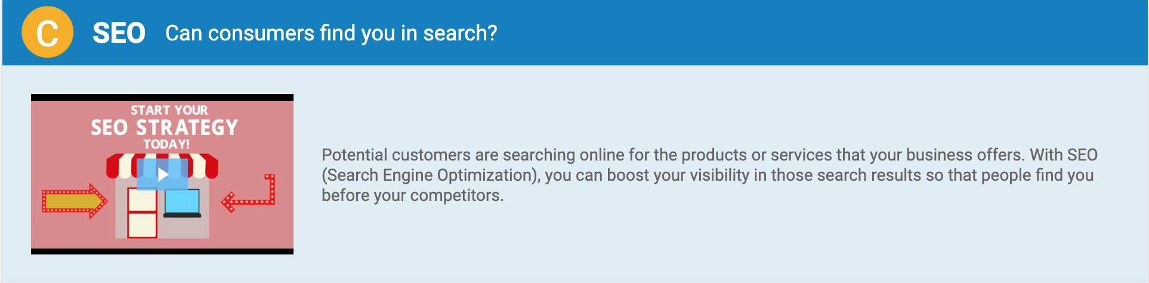
SEO Insights
The Snapshot Report provides valuable insights on how your prospect’s SEO stacks up against their competitors. The SEO section assesses SEO in three areas:
Local Search Results: View your prospect’s search ranking, exactly how it appears in Google Search.
Organic Keyword Performance: Compares your prospect’s keyword performance against their top competitors.
Organic Keyword Ranking: Assesses the top keywords that consumers are using to search for your prospect’s products or services.

Slide 50
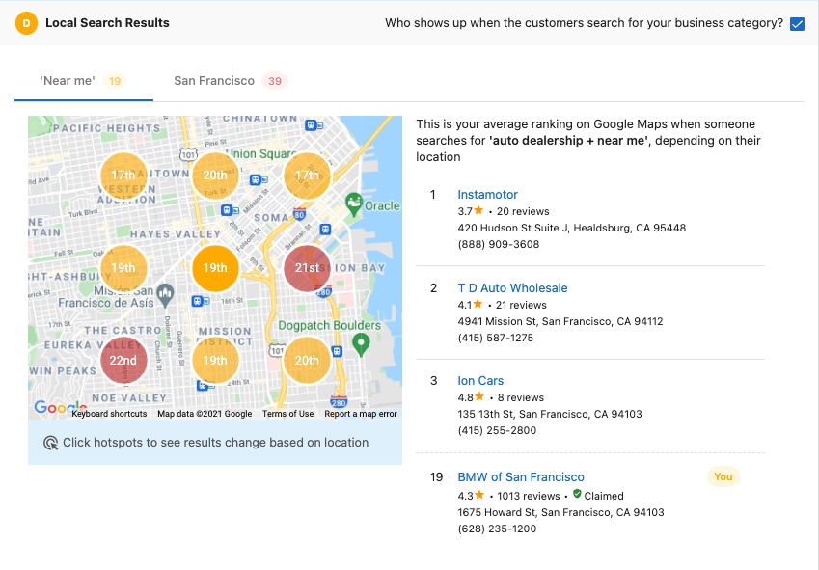
Local Search Results
We generate a keyword based on your prospects Google My Business account and primary business category, then perform a search for that keyword with “near me” added to simulate a prospective customer. We then display these results in both a map and search results format.
Notes:
When you create a Snapshot Report, the platform will generate a keyword for that business using the prospect’s Google My Business account and their primary business category. We then perform a search for that keyword with “near me” added to simulate what a prospect customer would do when trying to find a local business.
While this keyword is automatically generate when the Snapshot is created, it can be changed within the Snapshot Report settings found in Sales & Success Center. This keyword can be changed as many times as needed for 7 days after the report was created while the data is still fresh. After those 7 days, the Snapshot Report will need to be refreshed to update the keyword. It’ll take a few minutes for the search to be conducted and data updated, but allows you to customize the keyword that is used.
This data is then displayed in two different formats. The first is within a local map that’s broken into 9 hotspots. The second format is the top search results that appeared for that keyword.

Slide 51
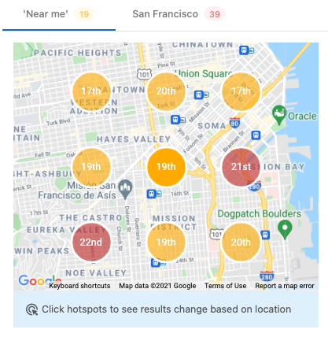
Local Search Results - Local Area Map
Within the local area map, you’ll find the search results displayed across 9 separate hotspots. This search is performed within a ½ mile radius around the prospect’s business. Each hotspot can be selected to see who they compete against, and the view can also be switched to a citywide level that will only display a single hotspot as it shows the prospect’s rank across the entire city.
Notes:
Within the local area map, you’ll find the search results displayed across 9 separate hotspots. This search is performed within a ½ mile radius around the prospect’s business.
Each hotspot displays the prospect’s search ranking for that area, and can be clicked on to display the local competitors for they compete against in that area.
You can also switch the view to a citywide level by selecting the tab above the map. This will only display a single hotspot as it showcase the search ranking across the entire city.

Slide 52
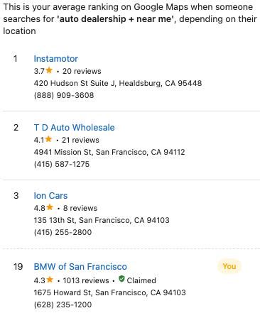
Local Search Results - Search Results
The second half showcases the actual search results for each hotspot. This displays the top 3 results, and where the prospect’s business lands. If they don’t appear within the top 3, you’ll see them below those results along with their actual rank.
This is also dynamic, so if you click on any of the 9 hotspots within the map you’ll see which competitors they’re up against in that area. You’ll also see if your prospect has claimed their GMB account, found in their business details.
Notes:
The second half of Local Search Results showcases the actual search results we were able to pull from each hotspot. This displays the top 3 results for each quadrant, and also shows where the prospects business falls within those results. If they’re not within the top 3, they’ll show up below those results along with their actual rank.
This section is also dynamic, and will change depending on which hotspot is selected. This will show which competitors are ranking within each quadrant, and allows the prospect who they’re directly up against within their local area. This can be an effective tool in showing your prospects who they’re directly competing with when it comes to local search, and they may even find businesses they never considered.
You’ll also see if the prospect has claimed their Google My Business account within their business details. They’ll either find a green claimed tag or a red unclaimed tag, indicating if they’ve completed this critical component to a strong online strategy. This can be a great way to open up the discussion around their Google My Business account.
This is a great starting point in any conversation, as this helps simulate the first stage of the customer journey. This is a critical step for any business to consider when building out their online strategy, so even if you don’t offer SEO services this can be an important step you want to highlight to show your expertise in helping local businesses.

Slide 53
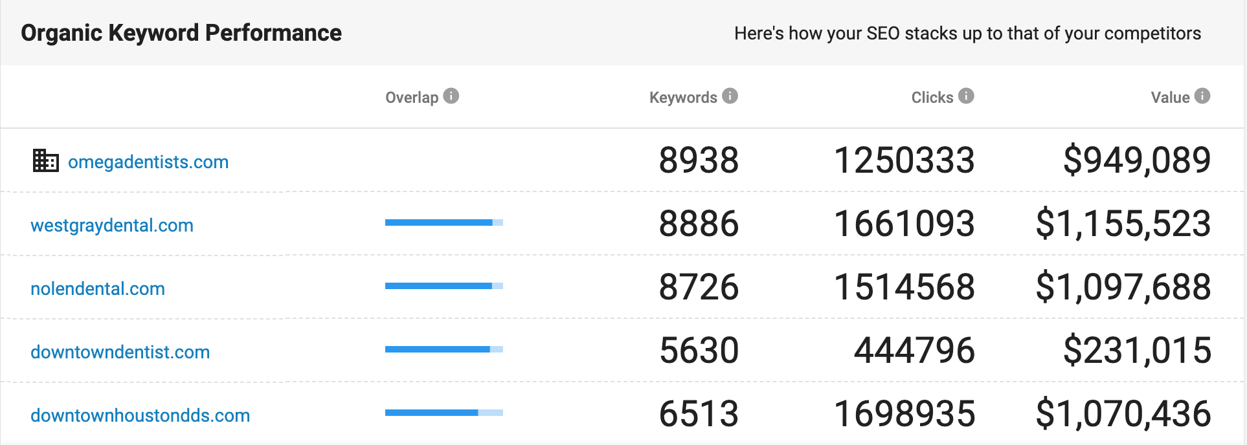
Organic Keyword Performance
Your prospect’s business website is scanned for the top keywords in the Snapshot Report’s database, as determined by Google. Based on these keywords, the report compares:
Overlap: How similar your prospect is to their competitors, based on shared SEO keywords.
Keywords: The number of keywords for which your prospect and their competitors appear in the top 50 search results on Google.
Clicks: The estimated number of clicks your prospect and their competitors get from all their organic keywords within a month.
Value: The estimated value your prospect and their competitors get from all their organic keywords within a month.
Your prospect
Your
prospect’s competitors
Notes:
When you create a Snapshot Report, the platform will automatically scan their business website for the top keywords in our database as determined by Google. Based on these keywords, the report generates a list of top competitors (also determined by Google).
Keyword Overlap: The more keywords that your prospect shares with competitors, the more likely they’ll be fighting to rank on the same search queries.
Number of Keywords: This is the number of different routes that a potential customer can take using search queries to get to the products and services that are on your prospect’s website. Your prospect should aim to have as many different search routes as possible to maximize their exposure and opportunities to gain clicks. If competitors with a high level of keyword overlap are ranking on more keywords than your prospect and seeing a higher volume of clicks, it’s possible that your prospect is not ranking on search queries that are relevant to their business and they’re losing out on potential traffic as a result.
Monthly Clicks: When people search for products and services on Google, they're usually looking to buy. So when people are searching for the products and services that your prospect offers, they’ll want to see as many clicks as possible. If the number of monthly clicks is low compared to the number of searches, you and your prospect need to figure out why. People could be visiting your prospect’s website via other channels (social media, advertising, print, etc.), but if they’re visiting competitor websites, it’s worth investigating further. It could be that they’re not ranked high enough on relevant keywords. In this case, an SEO campaign that boosts their ranking is definitely in order. Or, perhaps their business is perceived as untrustworthy due to a lack of online reviews. In that case, a review request campaign would be a more suitable solution. It's hard to pinpoint the exact motivations for every action within a consumer’s search journey, but this data can help you make some educated guesses. For example, does the report reveal a competitor with lots of keyword overlap and high clicks that eclipse the number of low clicks for your prospect? They might be losing business to their competition.
Monthly Value of Clicks: If a business wants to see results and they aren’t currently running any PPC campaigns, this section gives them an idea of how much a click would cost them on their relevant keywords. Remember that SEO campaigns take time. If your prospect needs immediate traffic (such as for a promotion or holiday season), focusing on a PPC campaign might be the best way to start.

Slide 54
SEO Grade Calculation
The SEO grade is determined by the percentile range the keywords’ estimated value per click falls into when compared to other businesses in the same industry.
Estimated Value Per Click = Estimated Monthly Value of Clicks / Estimated Monthly Clicks

Slide 55
Organic Keyword Ranking
This section uncovers the top organic keywords that your prospect is currently ranking for in Google searches. These are some of the top keywords that consumers are using to search for your prospect’s products or services.
These insights are valuable because they give you an idea of:
How people search for your prospect’s business online.
The types of keywords your prospect should be targeting in PPC campaigns.
The type of organic content your prospect needs on their site to gain relevancy.
This data empowers you to highlight the best SEO opportunities for your prospect, position yourself as the trusted SEO expert, and sell more SEO solutions.

Slide 56
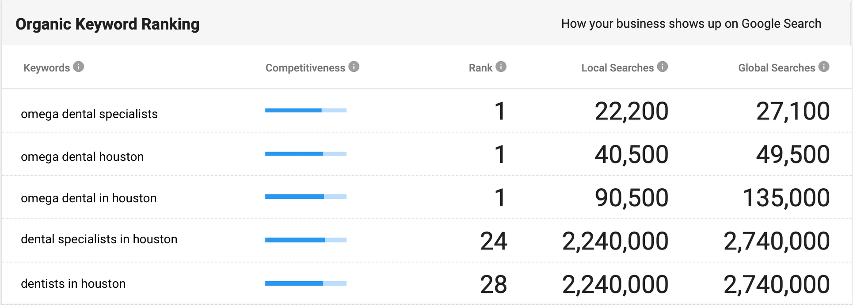
Organic Keyword Ranking
The report highlights to top five keywords that your prospect is ranking for within their business category. For each keyword, the report highlights:
Competitiveness: How difficult it is to appear in the top Google Search results.
Rank: The position of your prospect’s website in Google Search.
Local Searches: The estimated number of searches per month in your prospect’s country.
Global Searches: The estimated number of searches per month across Google.
Notes:
Competitiveness: The more competitive the keyword, the more businesses you’ll see targeting those exact keywords in SEO campaigns and the more effort will be needed to improve SEO. This is because those keywords are commonly used by consumers who are searching for your prospect’s business services and search engines deem them to be extremely relevant to their business category.
Rank: These are the approximate rankings for some of the keywords related to your prospect’s business category. You can leverage this information to ask if your prospect is happy with their current rankings on the keywords provided. If they’re happy, great! If not, you can start an SEO campaign for them right away. This is an excellent opportunity to spark a conversation around the specific keywords they may want to target with organic or PPC campaigns. Your prospect needs to understand that if their rank on high value, relevant keywords is low, competitors could be taking the lion’s share of clicks. Conduct an SEO audit and use keyword analysis tools like Ahrefs and Keyword Finder to find where those other opportunities might be.
Local Searches: This is relevant if your prospect is competing in a local landscape. When the number of local searches is high, it means that more people in your prospect’s country are finding and clicking through to their site when searching with the keywords surfaced in the report. It’s an indication that they should be targeting those keywords–especially if their rank on those popular keywords is low.
Global Searches: This is relevant if your prospect is managing a multinational enterprise. If the number of global searches is high, it means that many people all over the world are clicking on their site when using the search terms surfaced in the report. Once again, it’s an indication that they should be targeting those keywords, especially if their rank on those popular keywords is low.

Slide 57
Selling SEO
A successful SEO sales strategy starts with understanding your prospect’s current online performance. By auditing their SEO and assessing their needs, you’ll have a place to start the sales conversation. You’ll also be better equipped to close that deal with the perfect solution.
If the grade is high, congratulate your prospect! Earning a positive SEO grade requires hard work. That being said, there’s always room for improvement! Offer to manage and optimize their SEO strategy so they can focus on running their business.
If the grade is low, your prospect needs help! They don’t have enough time, tools, or expertise to research keywords, build links, manage their online reputation, create content, and perform all the other required tasks. With a strong SEO strategy, you can help your prospect get found online, increase customer engagement, increase organic website traffic, and produce real customer conversions!
Notes:
An excellent way to get started with your SEO audit is to use MarketGoo, which leverages artificial intelligence to scan a website and generate a step-by-step SEO plan to help your prospect increase their website traffic and rankings.
Other Helpful Local SEO Tools Include:
Ahrefs: A toolset for SEO & marketing that covers backlink checking, competitor analysis, keyword research and more.
Keyword Finder: A keyword research and analysis tool that will help you identify keywords to target.

Slide 58
Selling SEO
Follow these steps to sell SEO solutions to your prospect successfully:
Ask your prospect to consider their buying journey.
“What steps would you take if you wanted to find a good, local, and inexpensive restaurant for dinner tonight?”
Ask your prospect to consider their business’s place within that journey.
“Would it be valuable for your business to show up in searches when people use keywords related to the products and services you offer? People are more likely to click on your site when they are actively searching and ready to purchase. They are even more likely to click on your site when it appears at the top of relevant search results. How much is it worth to get that one click from a qualified audience?”
Notes:
1. Start by making your prospect think about the buyer’s journey and the importance of being found on search engines like Google and Yahoo! Try asking your prospect to consider the steps they would take in their buying journey. Chances are, they would search on their phone's browser to research local places.
"What steps would you take if you wanted to find a good, local, and inexpensive restaurant for dinner tonight?"
2. With the buyer's journey visualized, you’ll want your prospect to begin thinking about their place within that journey. Where can their business fit into that buying decision to catch more of that traffic? And what parts of that journey can they affect?

Slide 59
Selling SEO
Show your prospect the SEO section of the Snapshot Report.
“Based on these metrics, your competition may be a step ahead and stealing potential businesses right out from under you. Do you think it’s valuable for your site to appear at the top of search results when consumers are looking for your business services?”
Conduct a live demonstration. Open a search engine like Google and type in relevant keywords for their product offerings. Can you find your prospect’s business?
Use a keyword analysis tool to provide further insights.
Notes:
3. Review the information in the Snapshot Report to help your prospect understand their current SEO. Use the data in the "Organic Keyword Performance" section of the report to create urgency for your prospect to get started with a PPC campaign. If their competitors are ranking higher on searches when consumers are ready to buy, they'll steal that business!
4. When searching for your prospect’s products and services, is their website showing up on the first page of search results? If not, they’re losing money every day that their site is not optimized for search.
Pro tip: As the salesperson, you should do this BEFORE you meet with the prospect/client, so you’re not surprised by the results. You want to illustrate that they could be ranking higher on relevant keywords. And if needed, you can perform a more comprehensive SEO audit. Regardless, the SEO section of the Snapshot Report is useful for starting the conversation and identifying potential lead opportunities.
5. If your prospect wants to know how they rank for keywords other than the ones we report, you will need a specialized tool. Knowing which keywords to run a campaign with is typically the last hurdle in the sales process.

Slide 60
Elevator Pitch
Now that you understand the key components of selling SEO, you can begin to craft a compelling elevator pitch. Here’s a sample pitch you could use:
“People conduct more than 3.5 billion searches every day on Google. With a custom Search Engine Optimization strategy, we can ensure that your most valuable consumers see your business where it counts. SEO is about getting your website found on search engines like Google. Consumers see the top search results as the most trustworthy, which is why establishing good search rankings is absolutely critical. In fact, studies show that the first five search results get nearly 70% of all clicks, and 75% of consumers will never click past the first page of search. Furthermore, a whopping 88% of local, mobile searches result in a store visit within 24 hours! If you aren’t showing up at the top, you’re losing the battle. We can help you get found online with an SEO strategy.”
Notes:
When crafting an SEO pitch for a specific business, you’ll also need to consider these key details:
Who is your prospect trying to sell to? Different audiences have different search habits. Do they go on social media? Do they go on search? It’s important to craft a strategy that is targeted towards your target audience.
Who are their competitors? Who can we immediately identify as the top competitors to beat? What keywords are they ranking highly on or targeting in their campaigns?
What is their market size? A divorce lawyer in New York needs to capture the attention of a much larger audience compared to a small town gift shop owner. Evaluate your prospect’s market to set realistic benchmarks and goals for the campaign.
How many products and services do they offer? This will help you gauge the volume of keywords that the business should focus on.
What is their budget? Set a budget based on what your prospect wants to spend and what they can afford.

Slide 61
Final Considerations
Set the right expectations with your prospect. There is no single, ‘instant fix’ SEO solution—
it’s the sum of many small tasks that work together to elevate the ranking and visibility of a website over time.
Incorporate multiple solutions to build a solid foundation for good SEO. Online listings, reviews, digital ads, and social activity all contribute to search engine rankings for local search. By showing the Snapshot Report metrics to your prospect and connecting this data back to your available SEO solutions, you can deliver a compelling sales pitch that proves your ability to drive more brand awareness and conversions for any business.
Notes:
Elements to boost website ranking and visibility include mobile-friendly and Google-fast websites, providing web content that is relevant to customers, ensuring your prospect’s Google My Business page is claimed and verified, and creating and promoting a keyword-focused blog on your prospect’s site.
The more places your prospect is listed online, the more visible they become. The more positive reviews they receive for their business, the more trusted they become. The more targeted ad campaigns they run, the more paid traffic they can generate. The more social content they share, the more engagement they will experience. All these factors go a long way to influence how search engines perceive your prospect’s online relevance, and ignoring certain elements can have a detrimental impact on their overall SEO.

Slide 62
Ecommerce

Slide 63
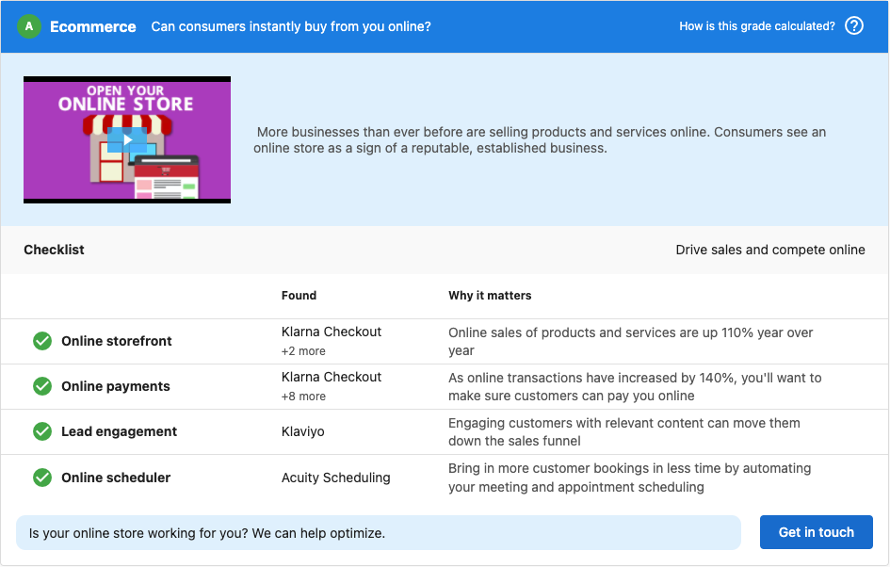
Ecommerce
Snapshot Report assesses your prospect’s website to determine if it’s capable of allowing customers to buy from them online.
The ecommerce section reviews:
Online storefront
Online payments
Lead engagement
Online scheduler
Notes:
Ecommerce can be a great way for local businesses to increase their revenue and customer base by ensuring their websites are ecommerce enabled. With 57% of consumers now expecting to be able to buy online from local businesses, ecommerce has become a vital component to any digital marketing strategy. If your prospect’s aren’t able to deliver on that expectation, their customers will seek out competitors who do offer an ecommerce solution to their needs.
Online Storefront: This checks to see if the prospect has the ability to sell their products/services through their website using a recognized commerce platform such as Shopify or WooCommerce.
Online Payments: This checks if the prospect is able to accept transactions through their site using recognized payment software such as Apple Pay or PayPal.
Lead Engagement: This scans the prospect’s website for software that allows them to engage with current or recent website visitors, helping to move those potential customers down the sales funnel. This includes solutions such as live chat or advertising campaigns.

Slide 64
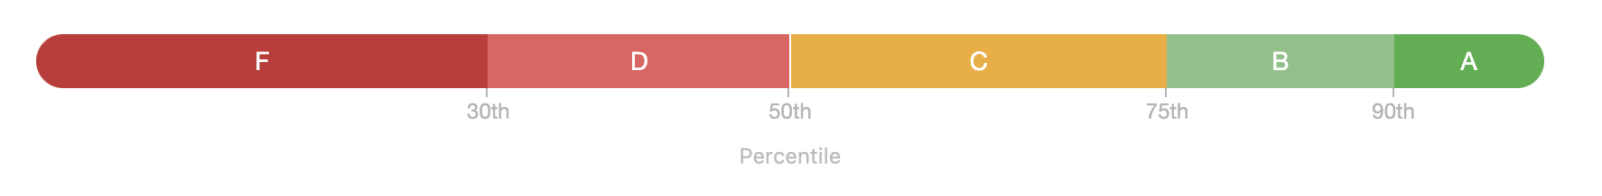
Ecommerce Grade Calculation
The Ecommerce grade is an indication of how well the prospect’s business is optimized for online transactions. This grade is weighted to match the insights of sales professionals, giving you a score that helps you focus on the areas that matter most. This areas are weighted as follows:
Online storefront = high
Online payments = medium
Lead engagement = low
Your prospects business is then ranked against their industry to determine their overall grade.

Slide 65
Selling Ecommerce
Buyer behavior has changed, and ecommerce has become an essential ingredient for your prospect’s success. Depending on the solutions that are found on the prospect’s website, you’ll need to adapt your talk track around the potential strategies you suggest.
If no solutions are found, you need to convey to the prospect how important it is for them to optimize their site for ecommerce. To compete in today’s online marketplace, your prospects need to offer a way for their customers to buy from them online, or else they could be losing significant revenue to their competitors. Try offering them a solution that covers multiple factors, like CalendarHero which can take care of both online scheduling and online payments.

Slide 66
Selling Ecommerce
If the prospect has a selection of solutions, here are potential talk tracks on the different combinations you may see.
If they have either an online storefront or online payments but are missing the other then that’s a great opportunity for you. If they have one but not the other, they’re missing a vital component to a comprehensive ecommerce experience. This is where you can offer them a solution that compliments what they already have and helps them to strengthen their ecommerce presence.
If your prospects don't have online scheduling, you can provide them with this vital solution to fill this void and ensure they're not losing market share to competitors. Enabling leads and customers to self-schedule appointments, classes, and meetings online is necessary for succeeding in a digital-first climate. Give your prospects a competitive edge, boost their booking rates, and help them convert those bookings into revenue faster by offering a scheduling solution like CalendarHero.
If they’re missing lead engagement software, then you’ll want to offer them solutions that can help to engage with prospective customers either on their site or after they’ve left. Online chat is a great way to ensure that their customers have a way to easily reach out with any questions they have, while marketing automation solutions like digital advertising can be effective in re-engaging visitors who have left the site.
If they do have lead engagement software enabled, ask them what sort of results they’re seeing. This can open up opportunities for you to step in with alternative marketing automation solutions that can help them increase their conversions from these initiatives.

Slide 67
Preparation

Slide 68
Research
The key to selling with the Snapshot Report is making sure that you are prepared.
Do your due diligence and research what services your prospect provides, how important digital marketing is to them, and whether they are currently using digital marketing products. Research their competitors to learn what they are up against. Good preparation will establish your credibility, boost your confidence, and set you up for success.

Slide 69
Focus
It’s important to focus on one or two sections of the Snapshot Report and highlight these areas as your prospect’s urgent needs. Instead of walking through the entire report, focus on selling solutions for areas with the lowest grades (F’s, D’s). This will prevent your prospect from feeling overwhelmed.
To highlight specific sections of the Snapshot Report, you can rearrange the sections so the most important sections appear first.* The remaining sections can be additional information, or you could cover them later in the conversation.
* Only available on Basic subscriptions and above.

Slide 70
Present Valuable Solutions
When Grades are Low
Identify your prospect’s needs, and then present valuable solutions that can fill those needs.
Instead of saying “your listings are broken,” come in and say “I’m going to help you with this. I’m going to deploy some strategies, whether it’s Listing Distribution or a Manual Claim of the big four sites.”

Slide 71
Present Valuable Solutions
When Grades are High
If your prospect’s grade is high, you can still present valuable solutions. A business that scores well against their competitors knows how important their digital marketing is, and they have likely invested a lot into establishing their online presence. This is a great place to talk about how they are doing so well. The work is likely taking up a lot of their time, and they could benefit from either offloading the work or using a tool to simplify the process. Offer solutions that empower your prospect to focus on what they do best—growing their core business.
This is also an excellent opportunity to employ a fear-of-loss argument. Businesses who are doing well need to stay vigilant to continue surpassing their competition!

Slide 72
Refreshing a Snapshot Report
Snapshot Reports are active and accurate for seven days. After then, the report will stop updating.
If you need more time to close a deal, or you simply need to rekindle an old prospect, you can refresh the Snapshot Report to provide up-to-date data.
Now go out there and make some sales!

Slide 73
Troubleshooting

Slide 74
Troubleshooting Guide
Issue | Explanation | Solution
My prospect’s reference business information (such as phone number, street address, website) is incorrect. | When Snapshot Reports are generated in bulk, the system scrapes the internet for repeating information and selects the most common data. If the Snapshot Report has incorrect anchor data, it means that incorrect business data is prevalent throughout the web. | This business needs help with listings! Offer solutions that will correct the incorrect listings and build new listings with the correct information.
My prospect’s social data is missing. | The social data could be missing because your prospect is marketing from a personal account, or their page has geographic or age-based viewing restrictions. The Snapshot Report can only find information that is publicly available on Facebook, so a business that limits their page to being found in certain locations or by certain age groups will not be found by the report (or any potential customer searching beyond those criteria). These limitations are often accidental, but block potential customers who might be trying to find them. | Create a business page for your prospect or remove the viewing restrictions.
I created my client’s website, but it received a low grade. Why is the website scoring so low? | The Snapshot Report is intentionally harsh, and the website section is no exception. The report uses Google’s PageSpeed Insights to grade websites. It’s difficult to keep up with Google’s latest algorithms! | The great thing about the Snapshot Report is that it suggestions solutions for each problem it finds with the website. Offer to help your client with these areas. If your client’s budget doesn’t allow you to make the recommended changes, you can always turn off this section of the report.

